Slide 1
The Importance of Being Android
By Daniel Muir

Slide 2
What is the project?
The project is to create an Android application to help users rehearse lines of a play
The play used for this App is The Importance of Being Earnest by Oscar Wilde

Slide 3
Why this project?
User can rehearse anywhere, anytime
Easy to rehearse with any character at any point in the script
Use of features not available with a paper script, such as recording and filtering
A Digital Partner to rehearse lines with and offer feedback

Slide 4
Designs
Home Screen
Options Screen
Statistics Screen
Main Screen

Slide 5
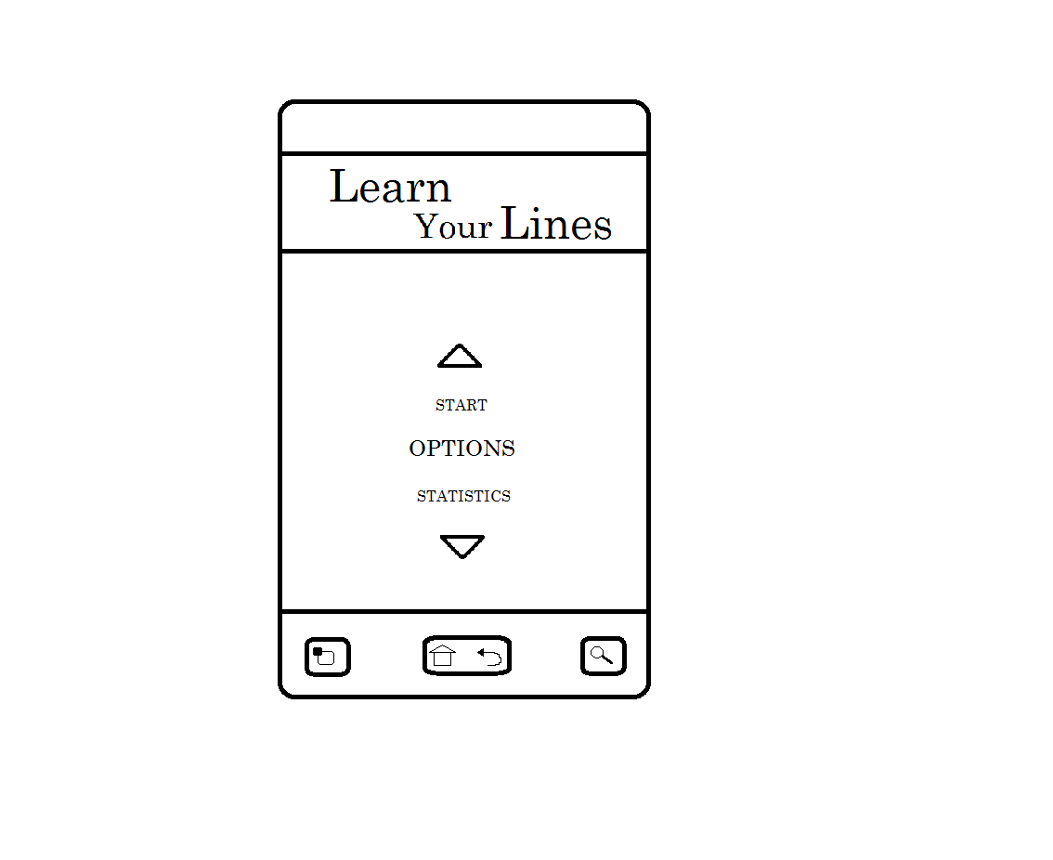
Design - Home Screen
Name of App
Menu Selection

Slide 6
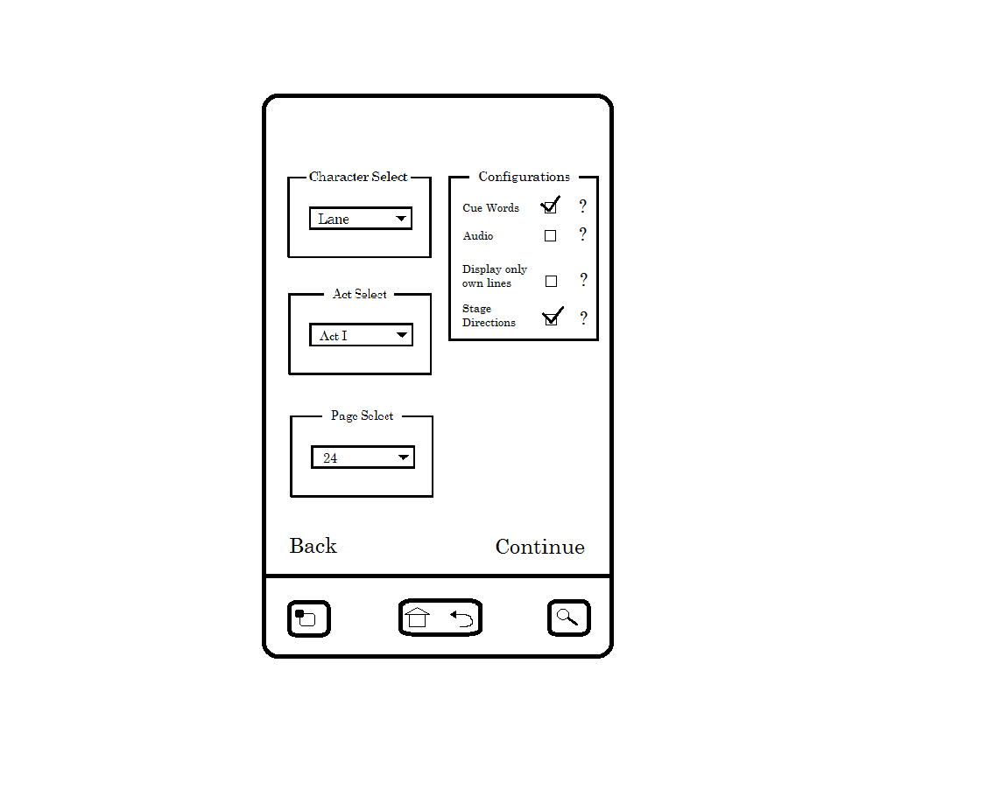
Design - Options Screen
Cue Words
Audio
Filtering
Own Lines
Stage Directions

Slide 7
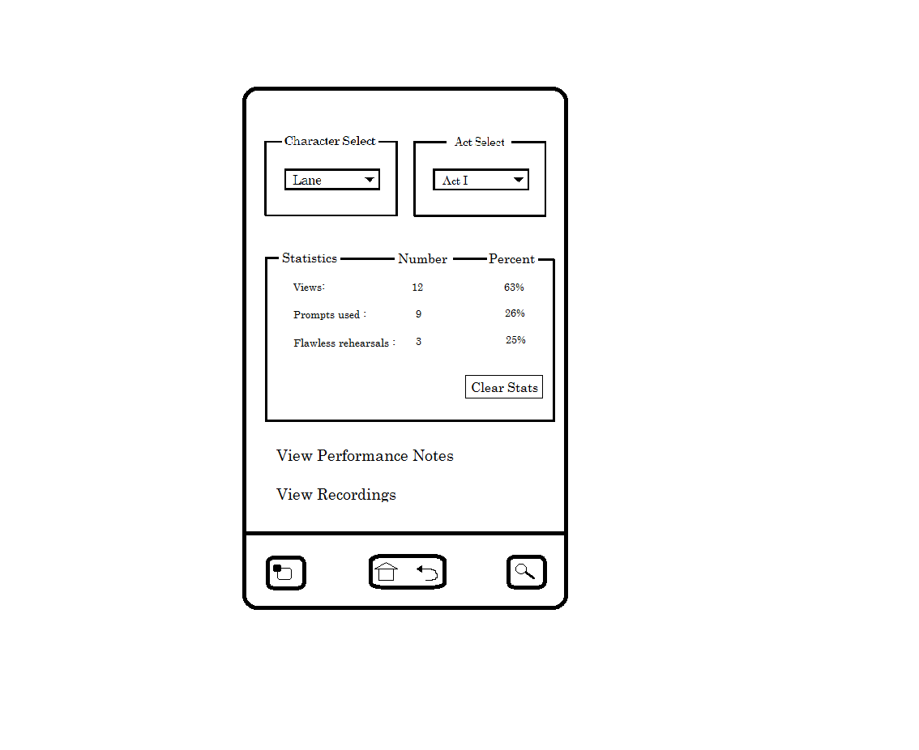
Design - Statistics Screen
Filtering
Views
Prompts
Statistics
Completions

Slide 8
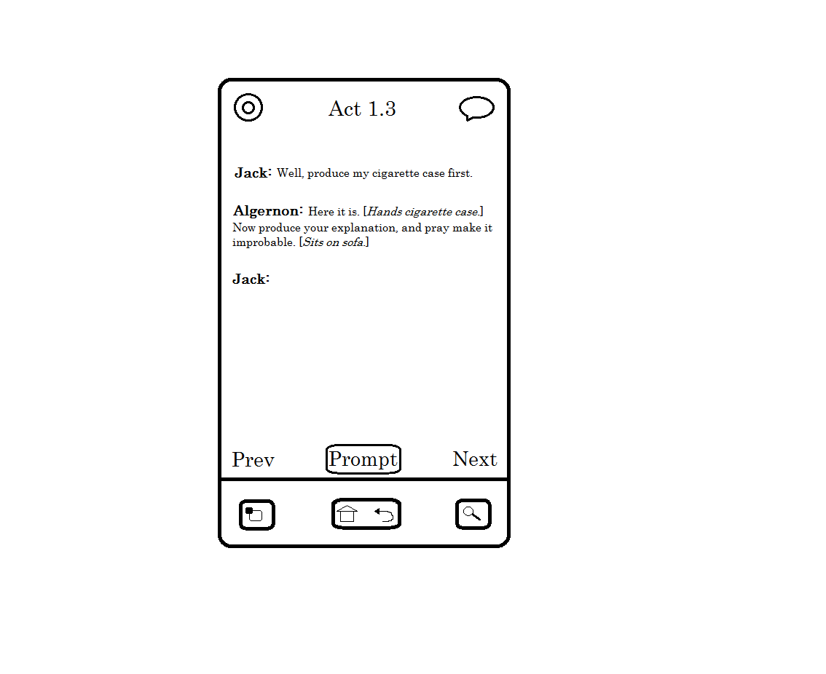
Design - Main Screen
Record
Notes
Prompt
Next/Prev

Slide 9
DEMO

Slide 10
What's Next?
Finish Implementation - End of Semester 1
Design and Implement Database
Add Performance Notes
Add Cue Words
Add Prompt
Add Additional Features

Slide 11
What's Next?
Test Project - February
Use Android Testing Frameworks e.g. Monkey to test functionality
Test project on a range of Android phones to evaluate design

Slide 12
What's Next?
Evaluate Project - February Week 3
Get a range of users to test App
Provide users with tasks to complete
Provide users with a Questionnaire to note their experience
Write Dissertation - April

Slide 13
Questions?

